Slide 1
Lead Score Casestudy

Slide 2
Title and content layout with list
Problem Statement
Business and Case study goal
Steps followed
Data Cleaning and Preparation

Slide 3
Problem Statement
X Education sells online courses to industry professionals. The company markets its courses on several websites and search engines like Google.
Once these people land on the website, they might browse the courses or fill up a form for the course or watch some videos.
When these people fill up a form providing their email address or phone number, they are classified to be a lead. Moreover, the company also gets leads through past referrals. Once these leads are acquired, employees from the sales team start making calls, writing emails, etc.
Through this process, some of the leads get converted while most do not. The typical lead conversion rate at X education is around 30%

Slide 4
Business and Case study Goal
Business Goal: To build a model wherein we assign a lead score to each of the leads such that the customers with higher lead score have a higher conversion chance and the customers with lower lead score have a lower conversion chance.
The CEO, in particular, has given a ballpark of the target lead conversion rate to be around 80%
Case study Goal: Build a logistic regression model to assign a lead score between 0 and 100 to each of the leads which can be used by the company to target potential leads.
A higher score would mean that the lead is hot, i.e. is most likely to convert whereas a lower score would mean that the lead is cold and will mostly not get converted.

Slide 5
Steps Followed
Step 1: Getting the data, Cleaning and Preparation
Fetch the data from the given database, clean data and convert the datatype, Outlier treatment, EDA
Step 2: Feature Scaling and Splitting data
Scaling the numerical variables and splitting data into train and test data
Step 3 Model Building
Feature Selection using RFE, Manual Feature Elimination, Calculate accuracy, sensitivity and specificity, precision recall and Model Evaluation
Step 4 Result
Evaluate the final prediction on test set.

Slide 6
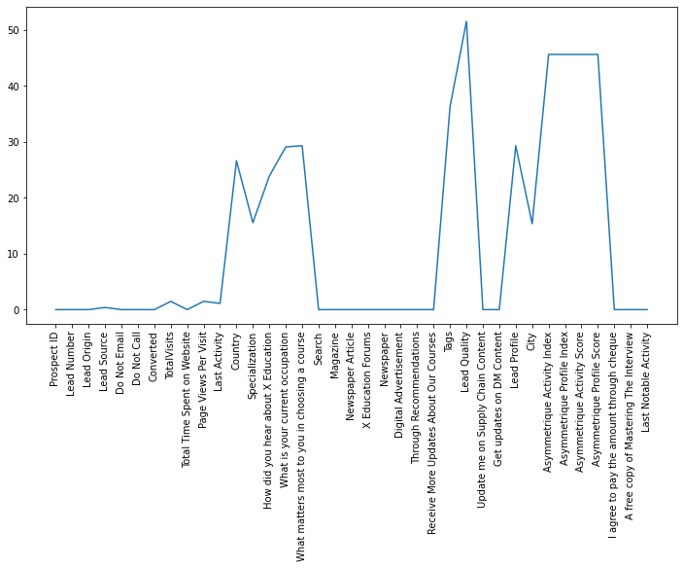
Data Cleaning and Preparation
Check percentage of null values and drop the columns that have more than 40% of missing values.
Then dropping variables where there are lesser unique values or add little value to the model to be built.
Replacing the value ‘Select’ with ‘Nan’ and further imputing the values with appropriate values in the later stages.

Slide 7
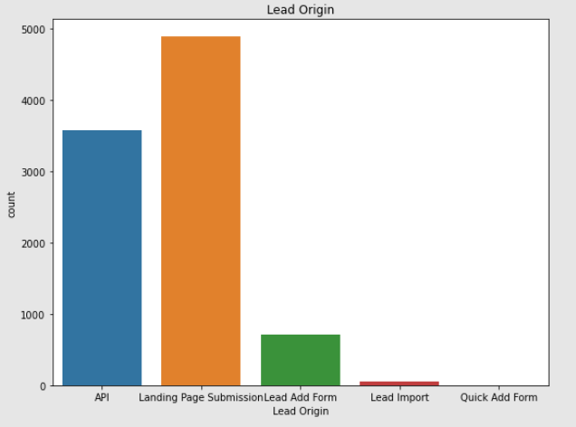
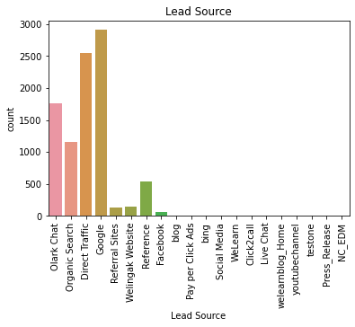
Univariate Analysis – Categorical
Lead Origin
Lead Source
It seems that most leads are from Landing Page Submission, followed by API, Lead Add Form, Lead Import.
Most of the lead are from Google, followed by Direct Traffic, Olark Chart and Organic Search.

Slide 8
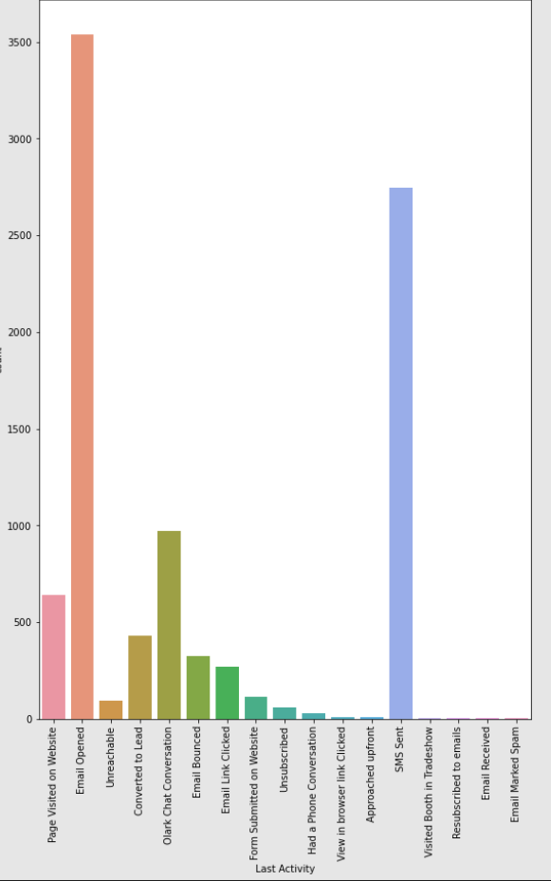
Univariate Analysis – Categorical
Last Activity
Most of the leads have opened their email.
The ‘others’ is a combination of all other categories expect the ones specifically mentioned in the chart and has a higher conversion rate ~70%.
SMS sent has about 60% conversion rate.

Slide 9
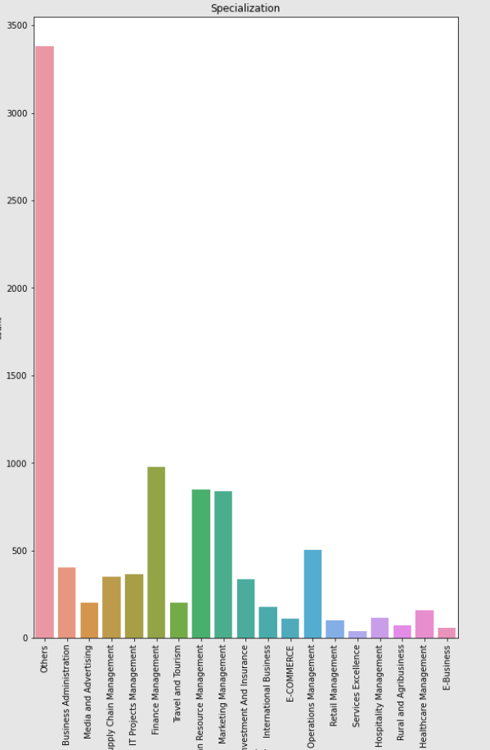
Univariate Analysis - Categorical
Specialization
Most of the leads have not mentioned their specialization and conversion rate among them is around 28%.
The rate of conversion for Finance and Marketing management is around 45%.

Slide 10
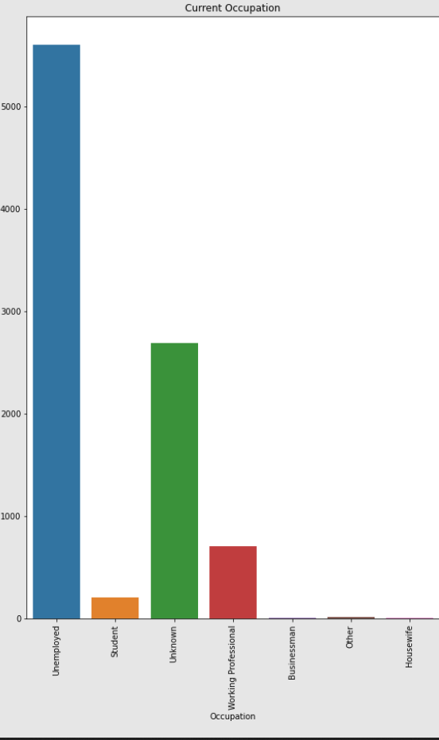
Univariate Analysis – Categorical
Occupation
Most of the leads seem to be from Unemployed section, following by working professionals.
There are number of leads who have not provided any information for occupation and considering them as Unemployed will skew the data. Hence categorizing them as Unknown.
Though less in number Housewives seem to have 100% conversion rate.

Slide 11
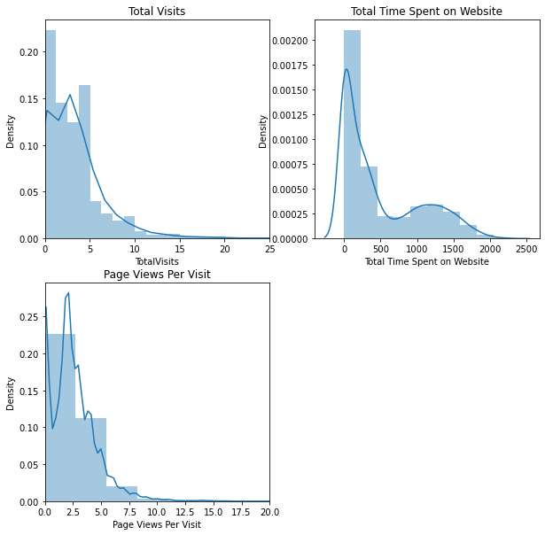
Univariate Analysis - Numerical
Total Visits, Time Spent and Page Views
TotalVisits and Page Views per Visit seem to have outliers which needs to be treated.

Slide 12
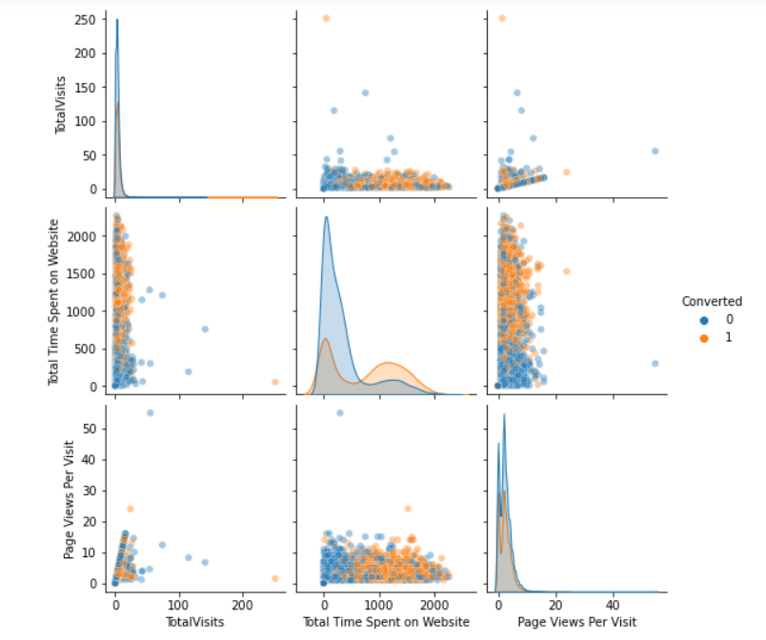
Bivariate Analysis - Numerical
Total Visits, Time Spent and Page Views
The features do not seem to be normally distributed.

Slide 13
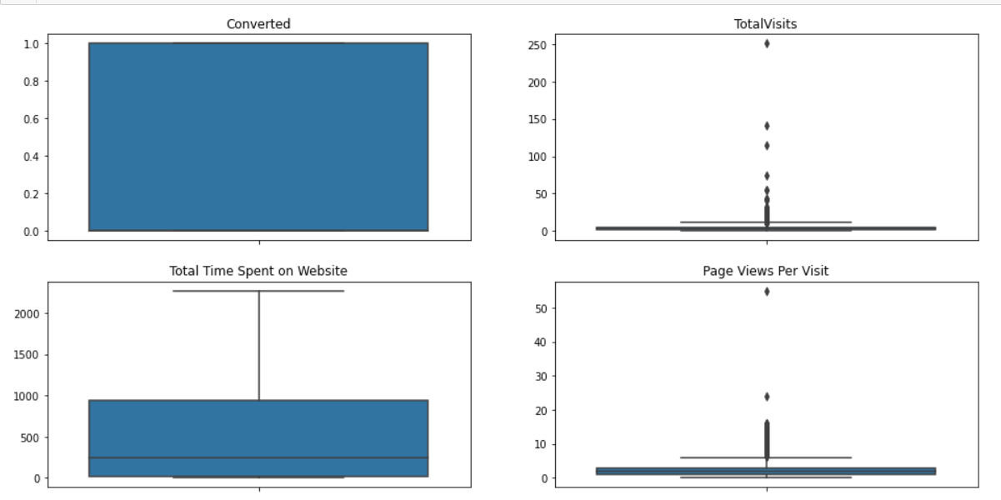
Columns Before Outlier Treatment
The outliers heavily influence logistic regression model and can cause bigger problems if not treated properly.
Hence capping the values to 95th percentile.

Slide 14
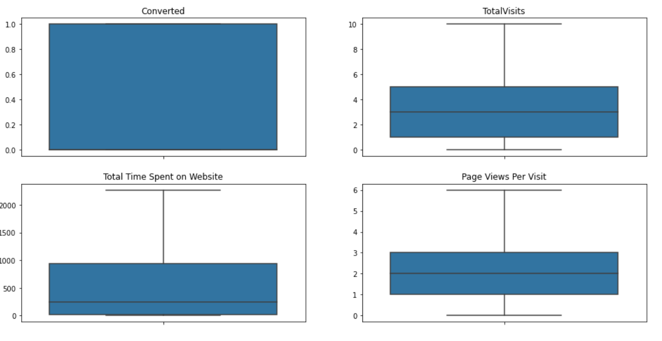
Columns after Outlier treatment
Values are fairly high in number.
The values of 95th and 99th percentile are pretty close hence the impact of capping is less.

Slide 15
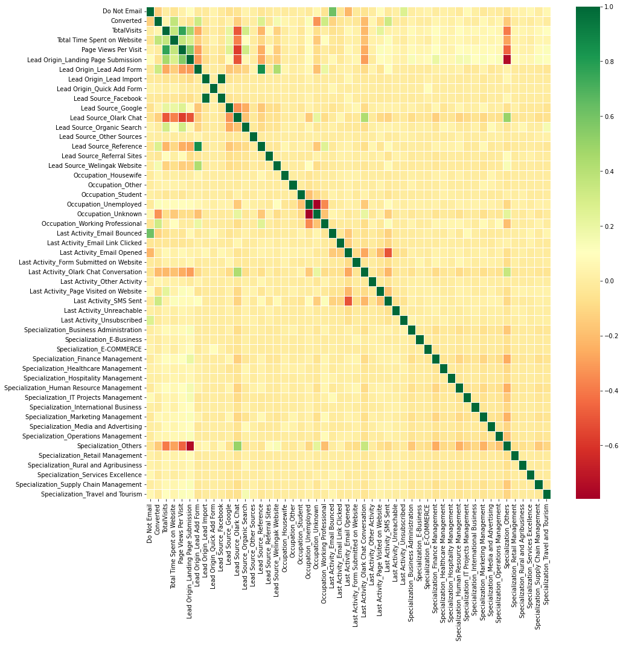
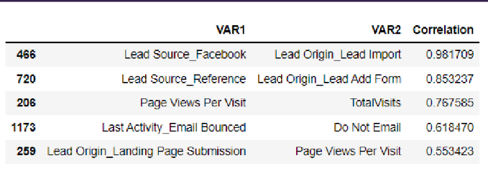
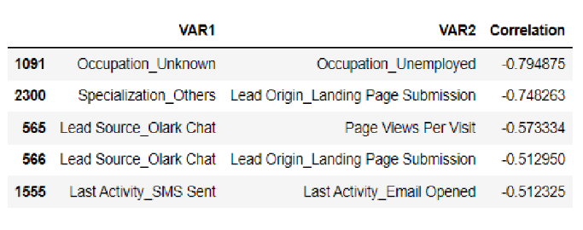
Correlation between variables

Slide 16
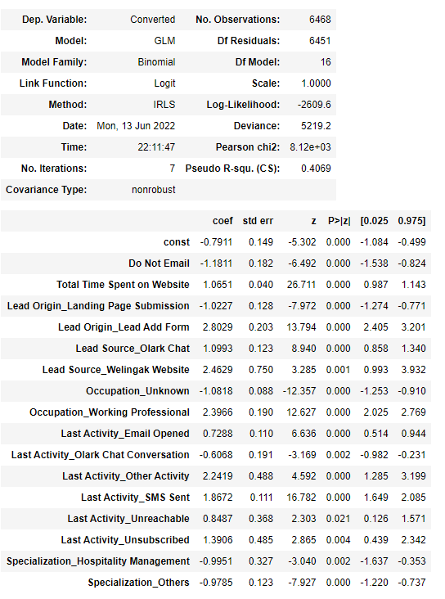
Model Building
RFE was done to attain the 20 relevant variables and manual feature elimination was done on p-values and VIF.
The p-value of all columns are kept below 0.05 and VIF below 5.
As a result the final dataset consists of significant variables for the regression modelling.

Slide 17
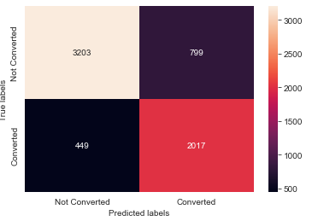
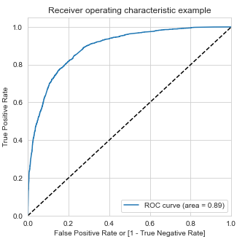
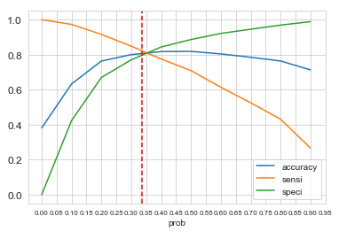
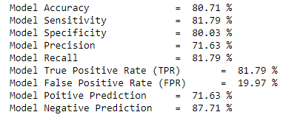
Model Evaluation Train Dataset

Slide 18
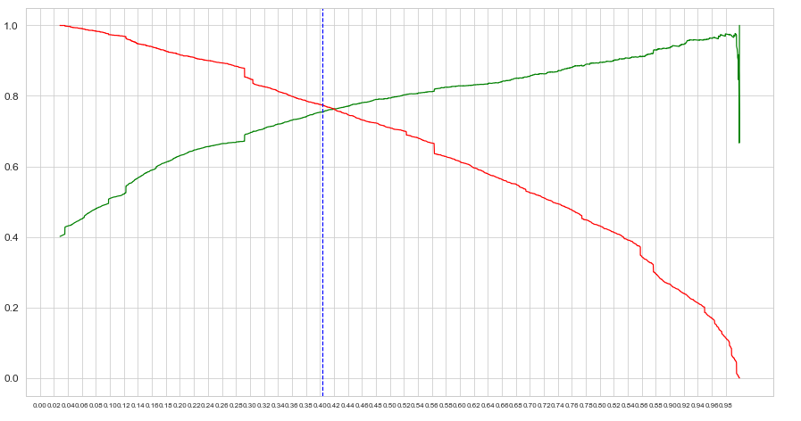
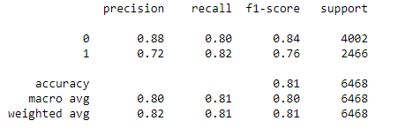
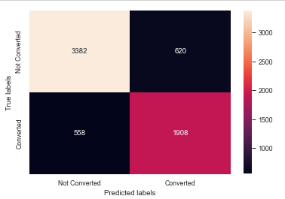
Precision Recall Trade - off

Slide 19
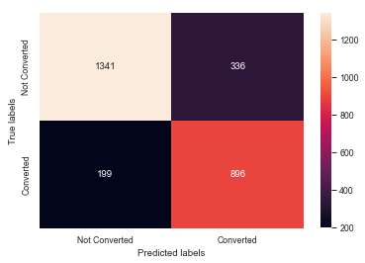
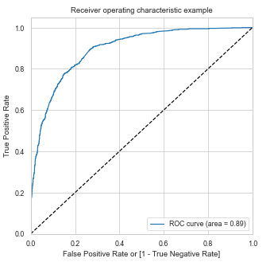
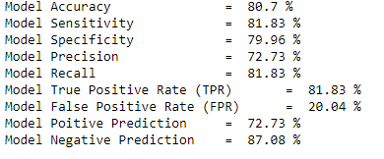
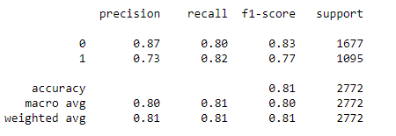
Model Evaluation - Test
The sensitivity of the model is around 81.83% which is close to the expected value of 80%. Hence the model can be considered as a good model.

Slide 20
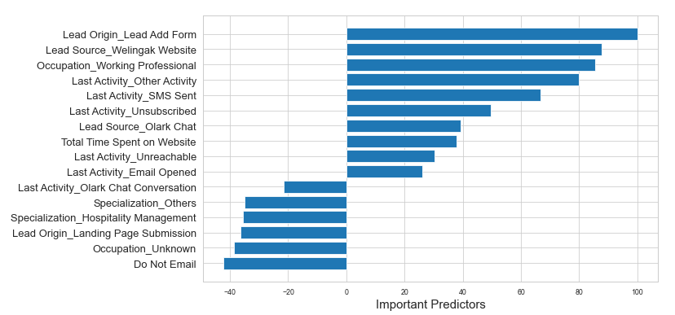
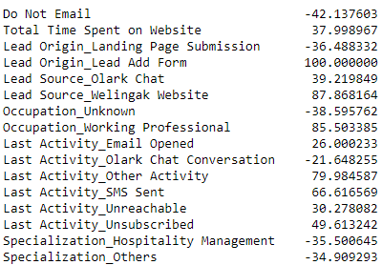
Conclusion - I

Slide 21
Conclusion - II
Major indicators that a lead will get converted to a hot lead:
Lead Origin_Lead Add Form : A lead sourced from Lead Origin_Lead Add Form is more likely to get converted
Occupation_Working Professional :- Working professionals are more likely to get converted.
Lead_Source_Welingak website : A lead sourced from Welingak Website is more likely to get converted.
Last Activity_SMS Sent :A lead having SMS sent previously are more likely to get converted.
Lead Source_Olark Chat :A lead sourced from Olark Chat is more likely to get converted

Slide 22
Conclusion III and Recommendations
Major indicators that a lead will NOT get converted to a hot lead:
Last_Activity_Olark chat conversation : Customers under olark chat, are less likely to get converted into hot leads.
Lead Ongin_Landmg Page Submission : Customers under Lead Ongin_Landmg Page Submission, are less likely to get converted into hot leads .
Do Not Email : Customer who choose Do Not Email are less likely to get converted into hot leads .
Recommendations:
The company should use a leads score threshold of 41 to identify "Hot Leads" as at this threshold, Sensitivity Score of the model is around 81% which is as good as CEO's target of 80%

Slide 23
THANK YOU

